Slide 1




TEAM - 10
2024WI_MSAI 437-0
IMAGE CAPTION GENERATOR USING CNN & LSTM
Team Members: Dev Ambani, Karan Garkel, Shreyasi Periketi, Shravan Srinivasan

Slide 2

OVERVIEW
Task Description
Dataset Description
Model Specification
01
02
03
Analysis of results
Results
Q/A
04
05
06

Slide 3

TASK DESCRIPTION
01
Image Captioning is the process of generating textual description of an image. The objective of the project is to predict the captions for the input image.
02
It seeks to automatically produce descriptive textual captions for given images.
03
This involves not only recognizing elements within an image but also constructing coherent, contextually relevant sentences that describe the scene.
04
The goal is to mimic a level of understanding and description, bridging the gap between visual data and its linguistic representation.

Slide 4
DATASET DESCRIPTION
01
The dataset consists of 8k images and 5 captions for each image.
02
The features are extracted from both the image and the text captions for input.
03
The features will be concatenated to predict the next word of the caption. CNN is used for image and LSTM is used for text.

Slide 5
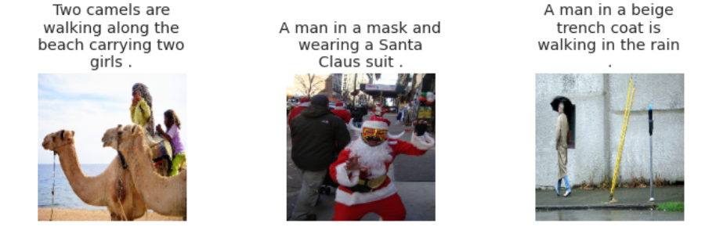
ABOUT DATA
01
The images and captions are sourced from Flickr, an online photo management and sharing application, and tend not to contain any well-known people or locations, but were manually selected to depict a variety of scenes and situations.

Slide 6
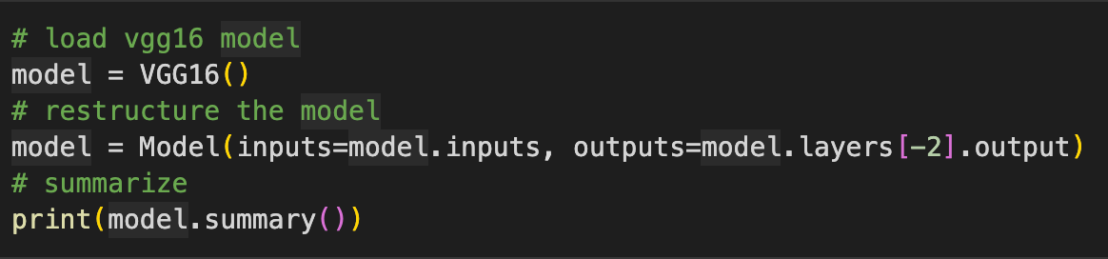
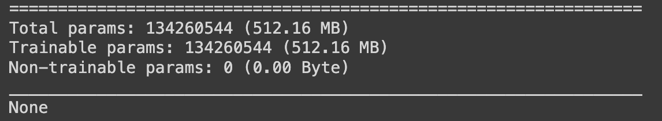
SUMMARY STATISTICS
01
IMAGE FEATURE EXTRACTION: VGG16 Model is used.
The model summary indicates that it has a total of 134,260,544 trainable parameters, all of which are trainable and none are frozen as non-trainable.

Slide 7
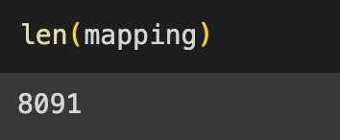
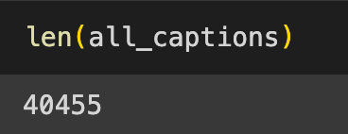
SUMMARY STATISTICS
02
Total Images: 8,091
Total Captions: 40,455
Average Captions per Image: Each image is associated with 5 different captions, providing varied descriptions of the visual content.

Slide 8
SUMMARY STATISTICS
03
The average caption length is approximately 11.78 words per caption.
There are 30,915 total unique vocabulary words used across all captions.
The top most frequent words are: "a" (38,280 occurrences)
"in" (18,961 occurrences)
The distribution of caption lengths shows that the most common lengths are 11 words (4,363 occurrences), followed by 10 words (4,307 occurrences), and 12 words (4,079 occurrences). This indicates a consistency in the length of descriptions provided in the dataset.

Slide 9
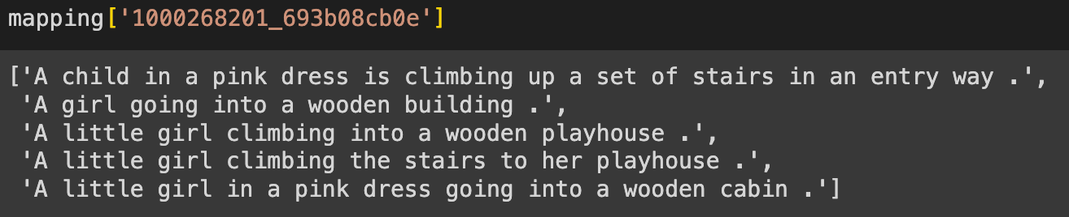
FEATURES
01
Rich Vocabulary: The dataset includes a wide array of words, from common ones to more specific descriptors, showing the diversity of language used to describe images.
02
Word Frequency Distribution: Highlights the commonality of certain words and phrases in describing images, which can inform the model's understanding of common visual-language patterns.

Slide 10
MODEL SPECIFICATION
01
To perform Image Captioning we will require two deep learning models combined into one for the training purpose, which are:
CNN
LSTM
CNNs extract the features from the image of some vector size aka the vector embeddings. The size of these embeddings depend on the type of pretrained network being used for the feature extraction.
LSTMs are used for the text generation process. The image embeddings are concatenated with the word embeddings and passed to the LSTM to generate the next word.
02
03

Slide 11
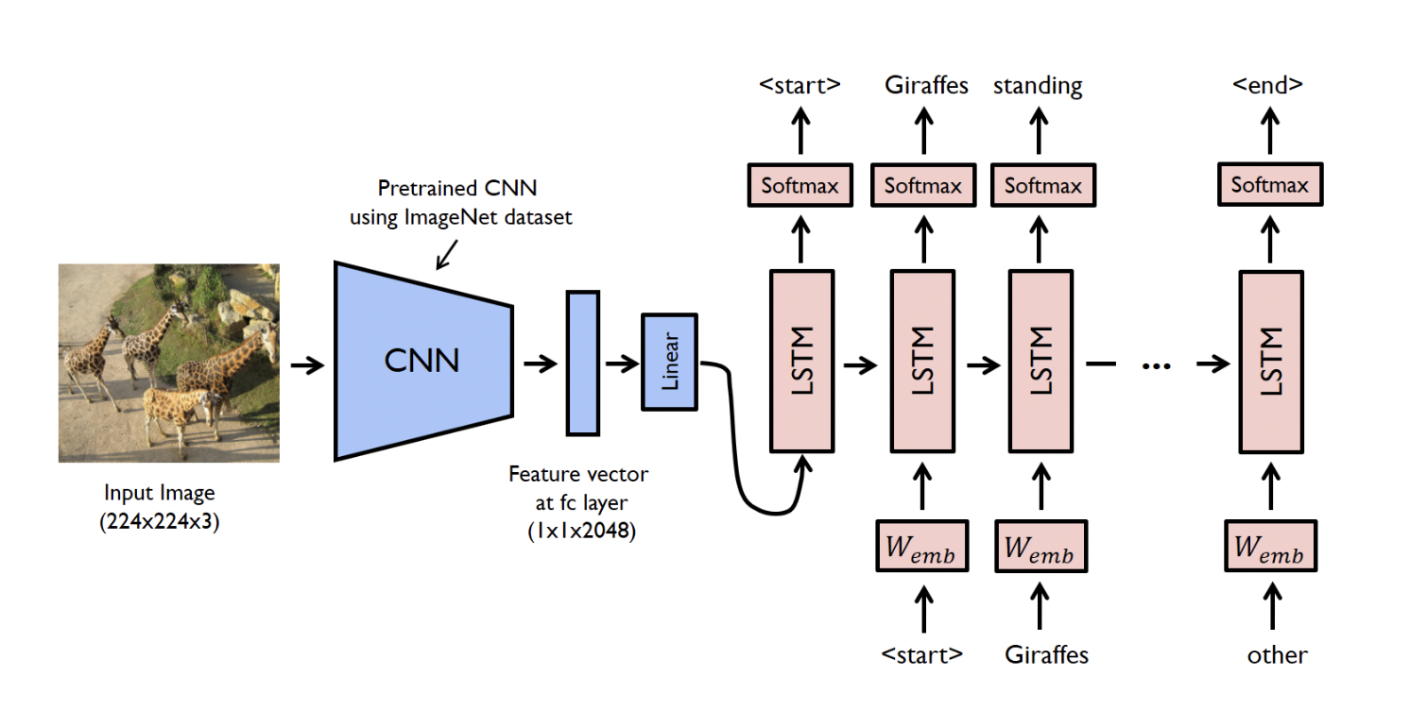
MODEL SPECIFICATION - DIAGRAM

Slide 12
CNN
01
This CNN acts as a feature extractor, analyzing the image and understanding its content by breaking it down into features.
02
The output from the CNN is a feature vector obtained from the fully connected (fc) layer of the network.
03
Linear layer is a transformation applied to the feature vector, typically used to reshape or scale the features before they are fed into the next stage of the model.

Slide 13
LSTM
01
The feature vector is then passed to a Long Short-Term Memory (LSTM) network. LSTM is a type of recurrent neural network (RNN) capable of learning long-term dependencies. It is used here to generate a sequence of words one after another.
02
Each word in the caption is represented as a vector in a high-dimensional space where semantically similar words are mapped to points close to each other. These vectors (embeddings) are used as the input for each timestep in the LSTM.
03
At each timestep, after the LSTM processes the word embedding, a softmax layer generates a probability distribution over the entire vocabulary for the next word in the caption. The highest probability word is typically chosen as the next word in the generated caption.

Slide 14
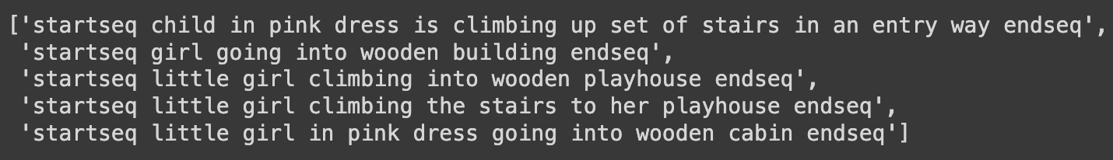
SPECIAL TOKENS
01
Special tokens are used to signify the beginning and end of a caption. The <start> token indicates the beginning, prompting the model to start generating a caption, and the <end> token is an indicator for the model to stop generating words, signifying the end of the caption.

Slide 15
RESULTS & ANALYSIS
01
PERFORMANCE OF THE MODEL:
BLEU scores are common metrics for evaluating the quality of text which has been machine translated from one language to another. In this context, they're being used to assess the quality of captions generated by the model against a set of reference captions.
The BLEU-1 score: This score considers only one-word phrases (unigrams).
The BLEU-2 score: This considers two-word phrases (bigrams).

Slide 16


VGG - BLEU-1: 0.538539, BLEU-2: 0.322250
ResNet50 - BLEU-1: 0.567415 BLEU-2: 0.341502
This is expected as matching longer phrases is typically more challenging for a language model.
These scores provide a quantitative measure of the captioning model's performance, with higher scores indicating better quality captions that are closer to human-written text.

Slide 17
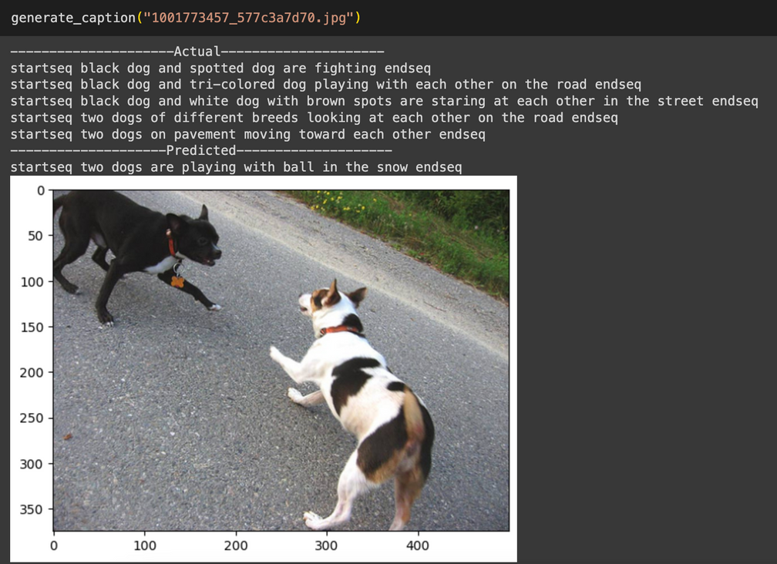
02
BASELINE RESULTS - VGG16
The actual captions are quite diverse, describing various aspects and actions within the image, such as the presence of two dogs, the act of seeing each other, and the act of playing.
The predicted caption captures some of these elements, such as a "Two dogs are playing with the ball in the snow."
This indicates the model's ability to correctly identify key elements of the scene, although it may not capture the entire scene as richly as the actual captions do.

Slide 18
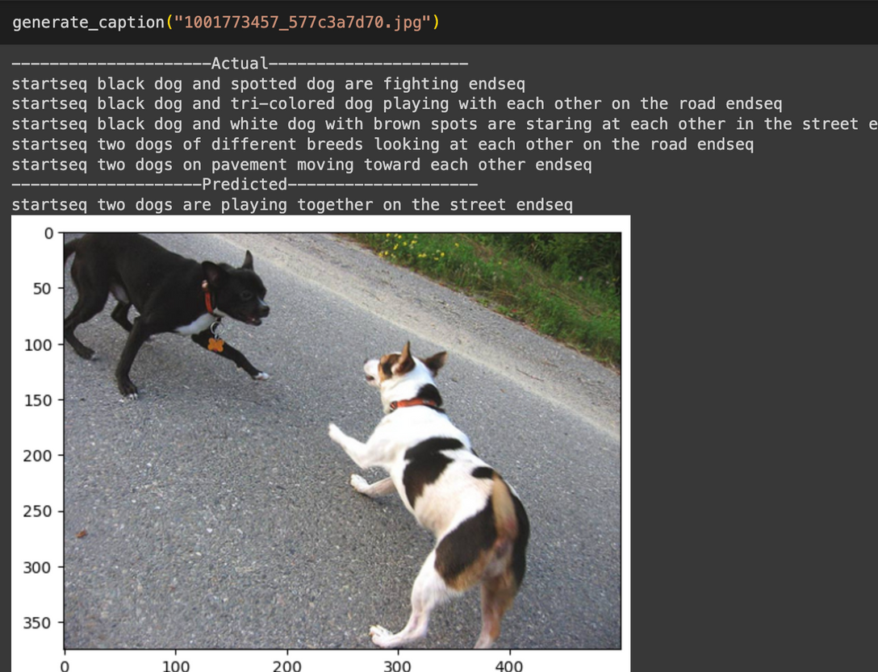
03
MAIN RESULTS - RESNET50
The top section of the text shows actual human-written captions describing the image, where various aspects such as the dogs' colors and actions are mentioned. The predicted caption from the model simplifies these descriptions to "two dogs are playing together on the street," which is a correct observation.

Slide 19
04
LIMITATIONS
The complexity of natural language and the subtleties of visual perception that may not be captured by the model.
The dataset itself may not be diverse enough to encompass the wide variety of real-world scenarios, leading to a model that performs well on the dataset but poorly on images outside of that context.
The issue of model interpretability and the black-box nature of neural networks, makes it hard to understand how the model arrives at specific captions.
No matter how well are the captions generated by the model, it might lack the creativity and emotional depth that human-generated captions provide, and there could be potential biases encoded in the data that affect the model's output.

Slide 20
05
KEY ASSUMPTIONS
The comprehensiveness and quality of the training data directly influence the model's performance. It is assumed that the dataset has adequately varied and descriptive captions that cover a wide array of scenarios the model will encounter.
The model assumes that the visual features extracted from the pre-trained CNN are sufficiently representative of the image content to generate relevant captions.
There is an underlying assumption that the sequential nature of the language model (e.g., LSTM) can capture the variations of language necessary for caption generation.

Slide 21
TEAM - 10
2024WI_MSAI 437-0
THANK YOU

